Slide 1
Some information from Nextef
For poster session in IWLC
T. Higo

Slide 2
Conclusion
Damped structure TD18 was tested
  The BDR seems a little worse than T18.
  Dark current was measured with beta from time to time. Beta X Es seems roughly speaking constant.
Very long-term operations
  BDR decreases but huge time is needed to reach 10⁻⁷. Can it be done gradually during operation?
  Need to evaluate the phase shift for this and compare with that of TD18_#3 tested at SAC for much shorter period.
Various findings and issues
  Vacuum pressure gets worse at a few to 10MW level and it is reproducible.
  Double pulse operation was tried. The BDR for each pulse, former and latter, seems the same.
  SEM view was taken and we see gap at the highest magnetic field area. Flatness and bonding jigs may be the issue for improving diffusion bonding.

Slide 3

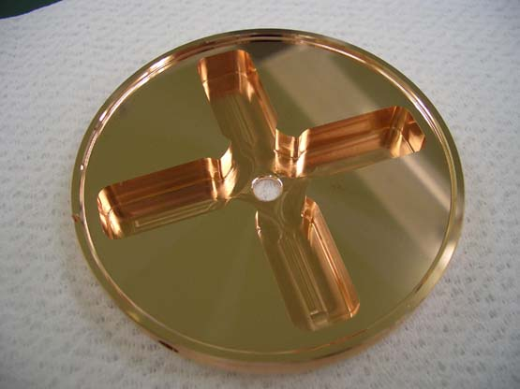
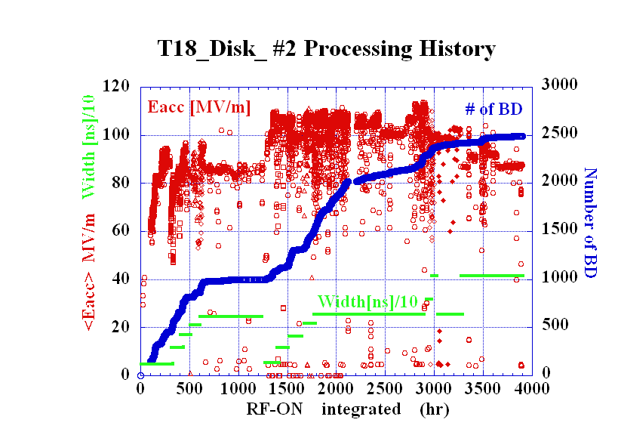
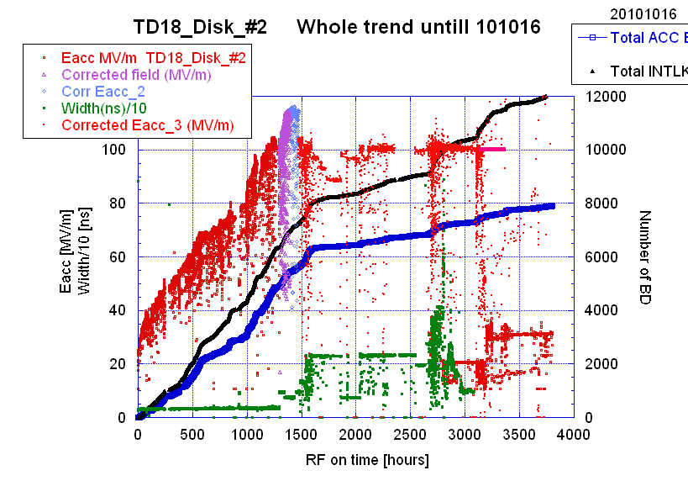
T18_Disk_#2
Undamped disk-based
Strategy
Disk-based
CLIC electric design
KEK mecha design +fab
SLAC assembly
Test at SLAC and KEK
TD18_Disk_#2
Damped disk-based

Slide 4
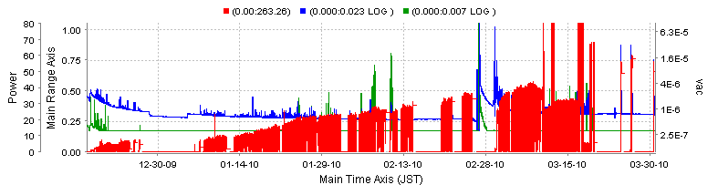
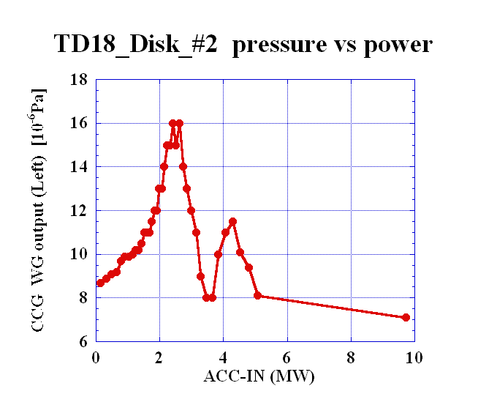
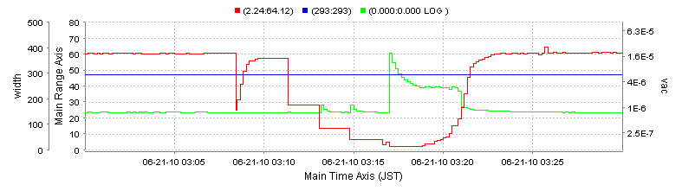
TD18: Characteristics in vacuum pressure increase at very low power level
VAC-@OUT-WG
ACC-IN power
VAC@IN-WG
Vacuum level was not so good, ~1x10^-6Pa at worst location.
Even after running at top power, the vacuum gets worse when it decreases power.
A few hour stop of RF pulses makes the vacuum level worse in the next startup process, during the recovery passing through the region.
It is reproducible.

Slide 5
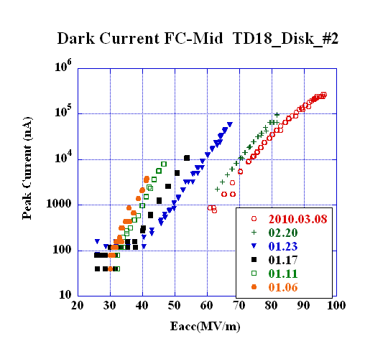
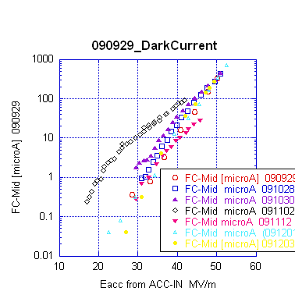
Presented to IPAC10
Comparison of dark current
T18_Disk
TD18_Disk
TD18_Quad
TD18_Quad
Eacc for peak dark current of 10 μA
90MV/m 70MV/m 40MV/m
The amount of the dark current tells the performance of the high gradient breakdown performance!?

Slide 6
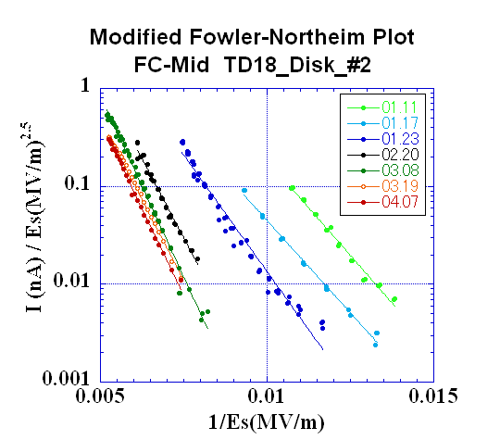
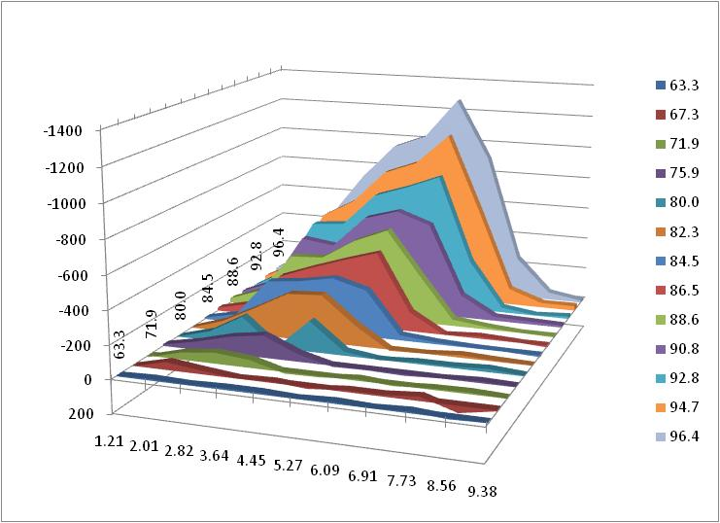
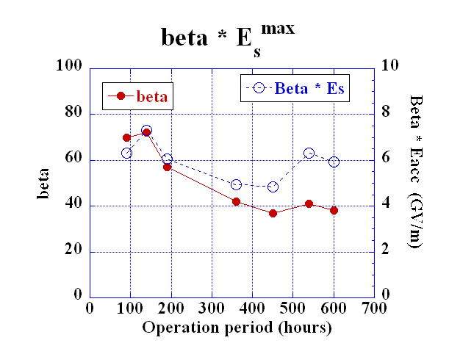
TD18_#2: Evolution of dark current and its spectra
Peak Current
(nA)
Averaged Gradient
(MV/m)
MV/m
Electron Energy (MeV)
In T18_#2 at 108MV/m, energy peak at 7.5MeV and 3.5MeV, similar to TD18 shown here.
Dark current reduced by three order of magnitude.
It followed roughly modified F-N formula.
β reduced from 70 to 40.
β * E_{s}^{max} ~ 5~7 GV/m

Slide 7
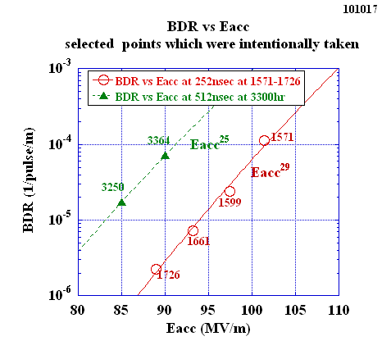
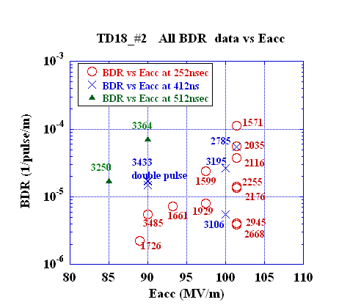
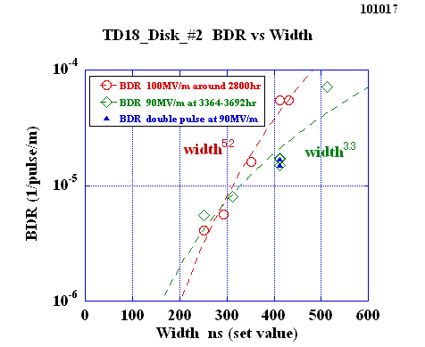
Breakdown rates in various cutting views
Eacc
width
Always changing in this stage of processing, only (? !) a few thousand hours since time=0.

Slide 8
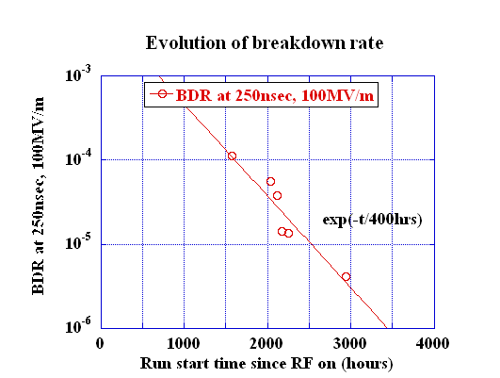
Break down rate evolution in TD18_#2
In a short period
Decreasing in a logarithmic time scale BDR ~ t^-0.38
# BD
BDR 10^-6 /pulse/m
Pick up 252 ns
Need too much time to reach 10⁻⁷ level.
Cannot wait this long time. Need proper care in fabrication.

Slide 9
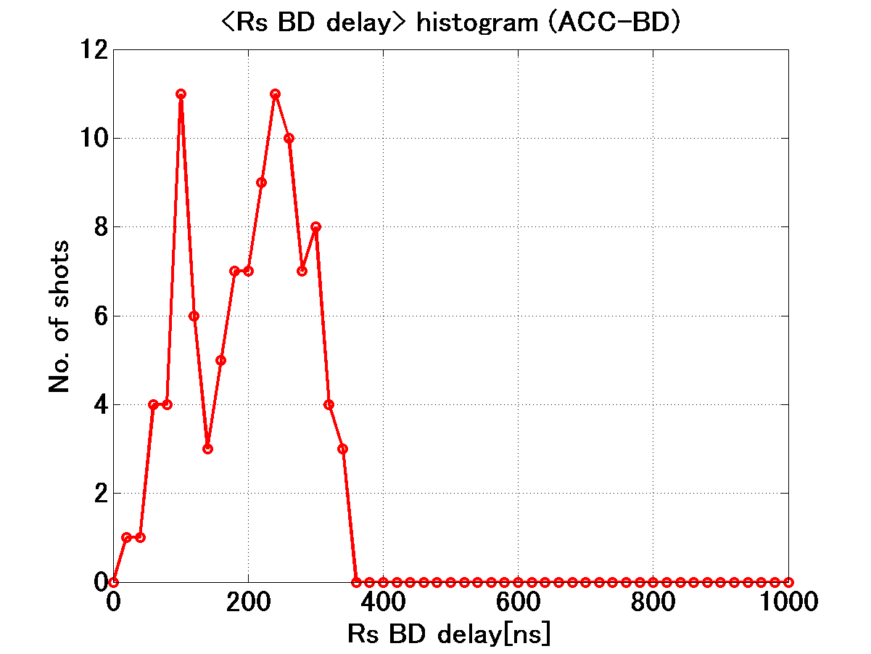
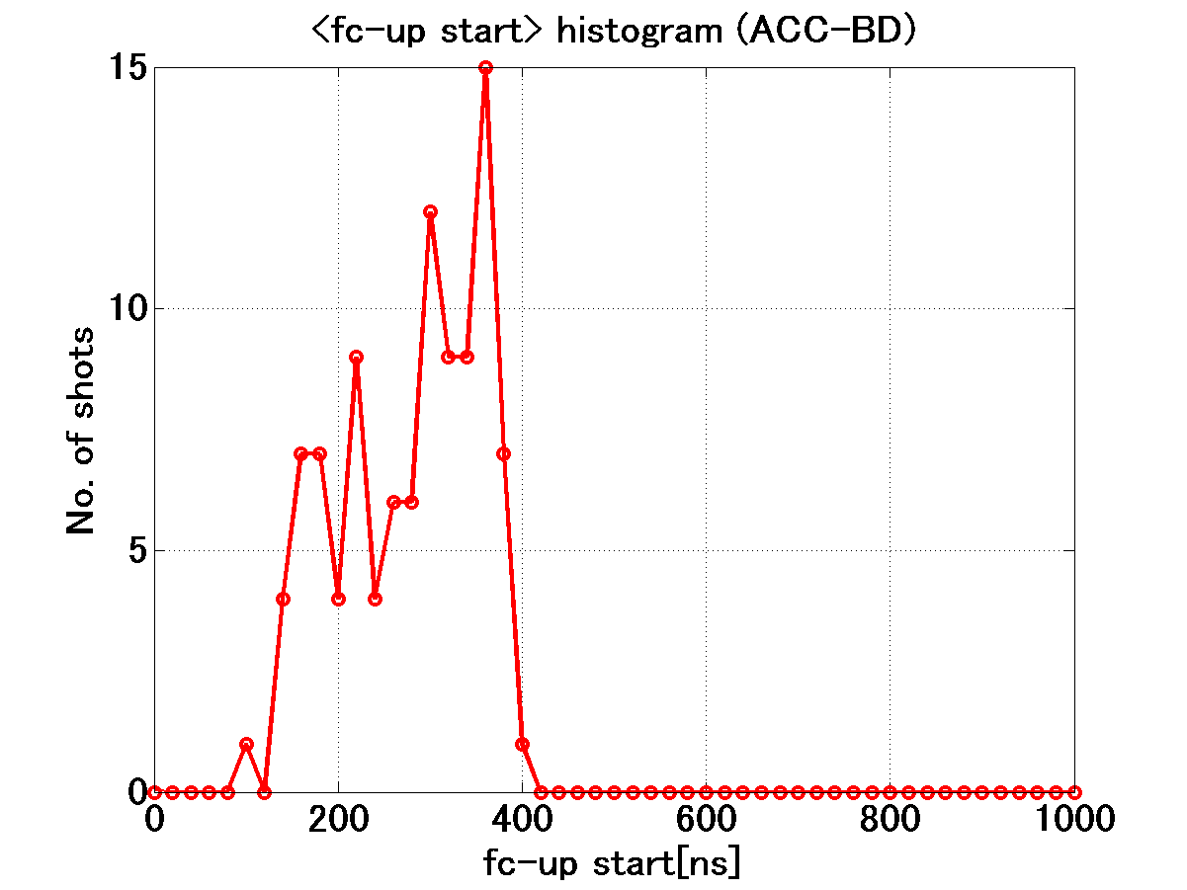
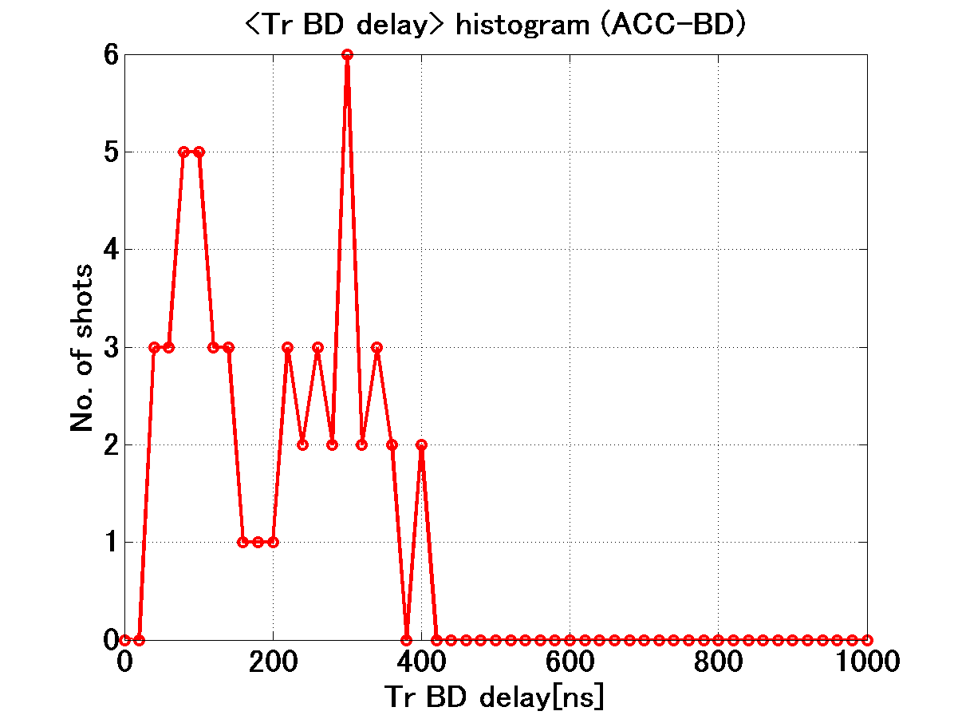
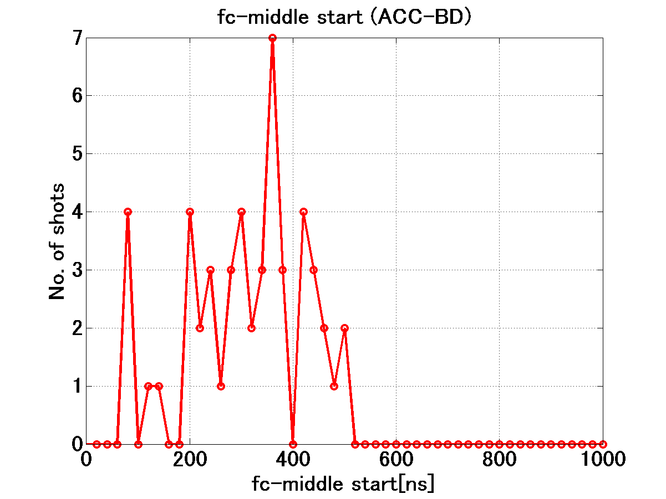
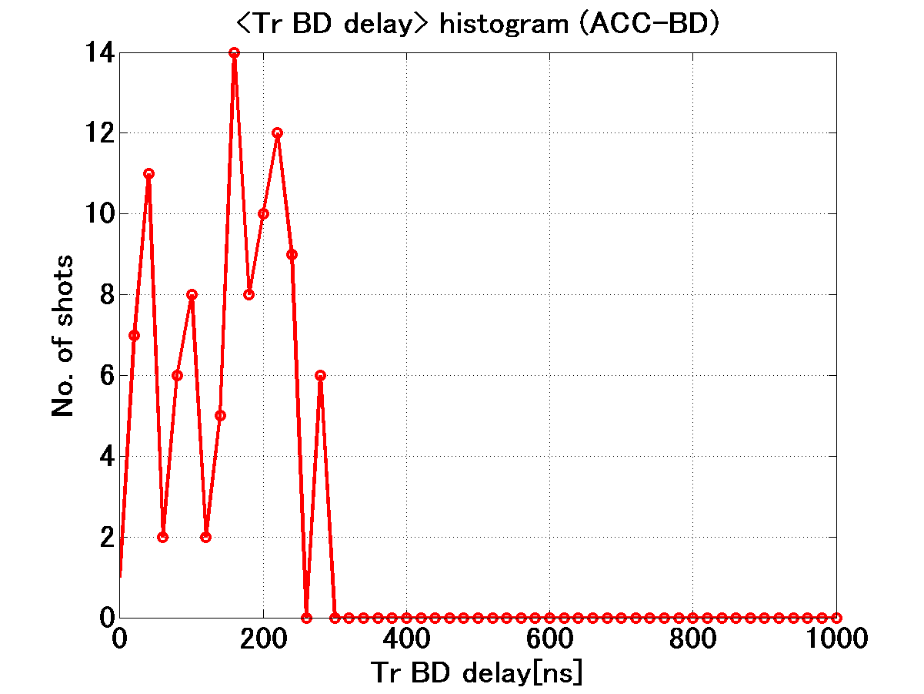
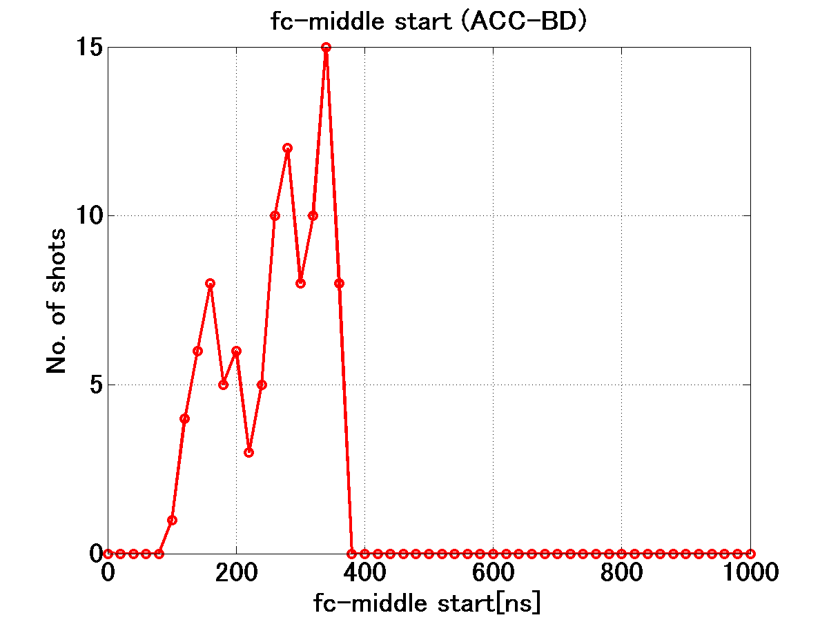
When in the pulse breakdown starts?
252 nsec run
512 nsec run
fc-mid, Tr-delay
→ramping as time
→ building up as time?
Little increase vs time!
Different from the left figures.
Need more statistics to judge.

Slide 10
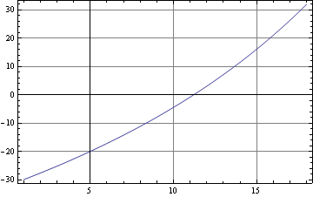
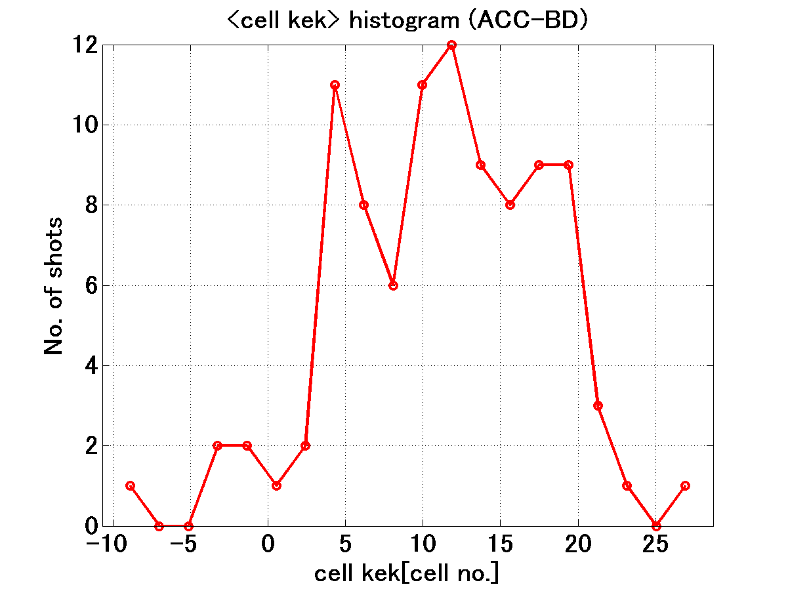
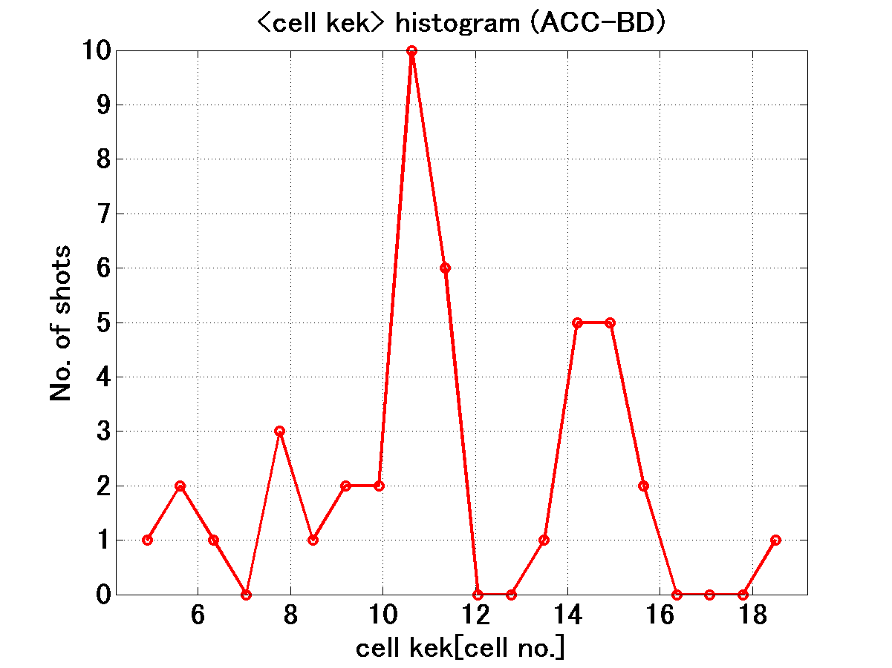
51+52 BD position
Time difference between Rs and Tr
Where in the structure the breakdown happens?
82 BD position
More to be confident.

Slide 11
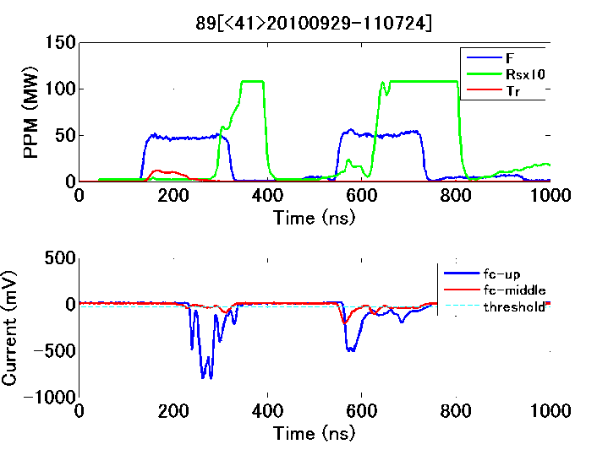
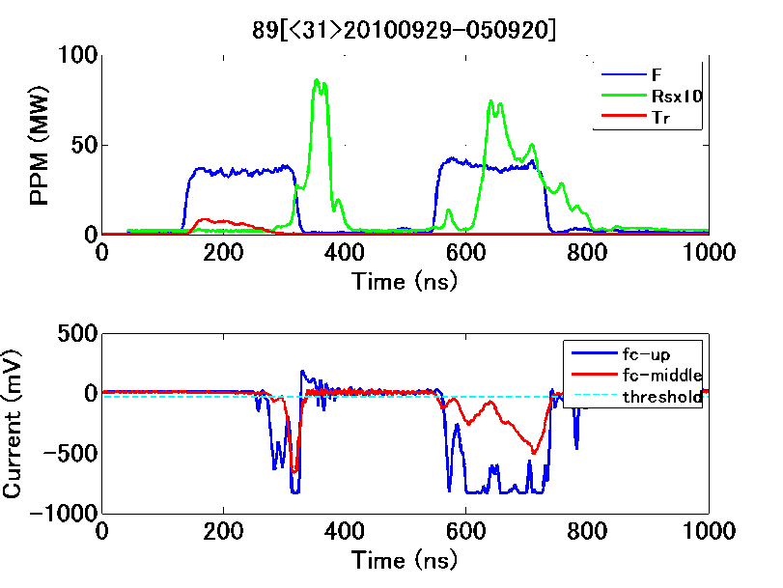
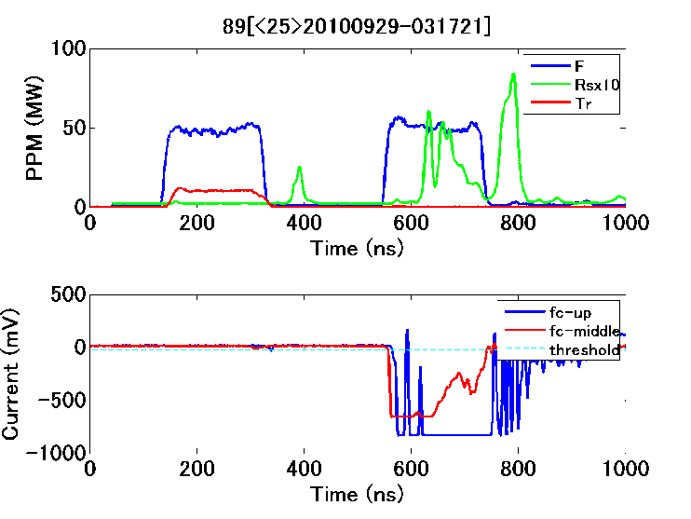
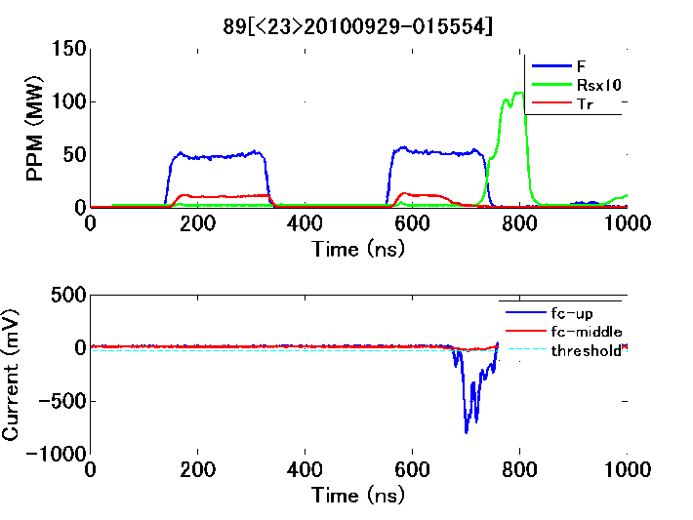
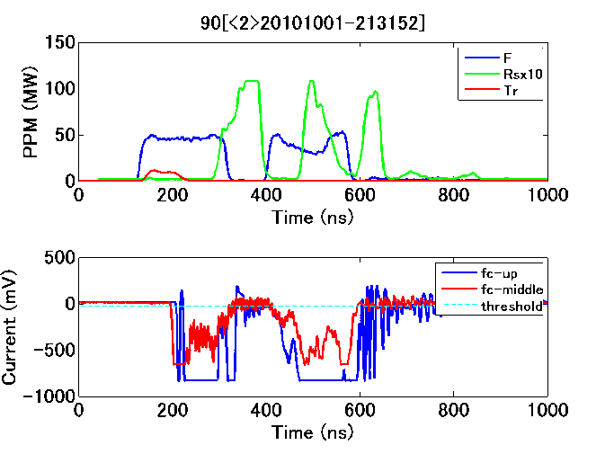
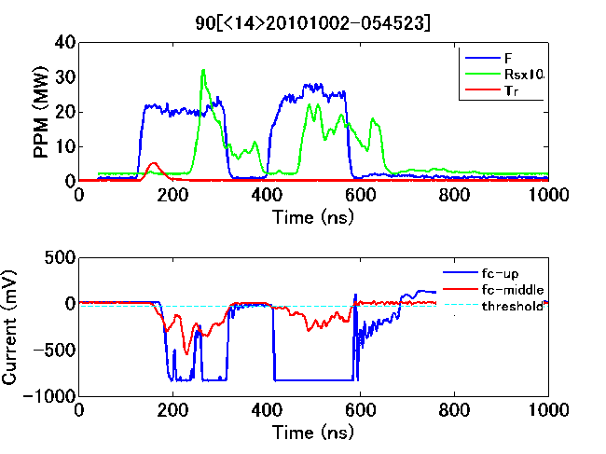
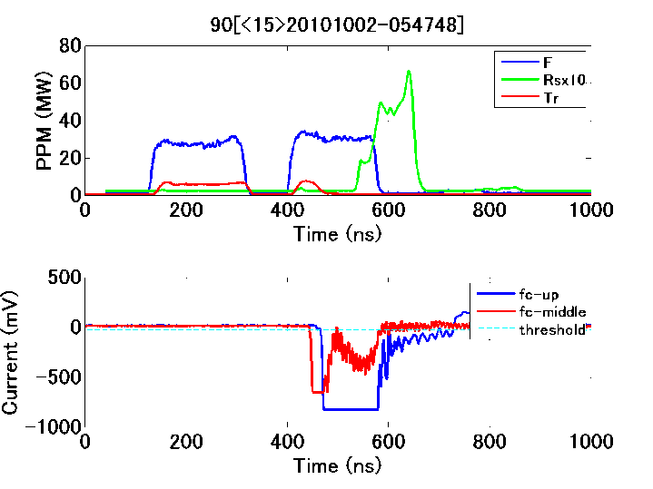
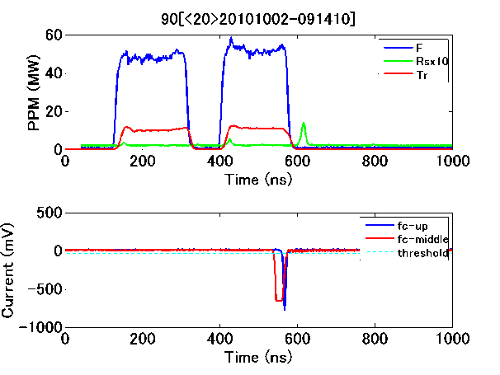
200ns + 210ns + 200ns
Duble pulse operation
200ns + 50ns + 200ns

Slide 12
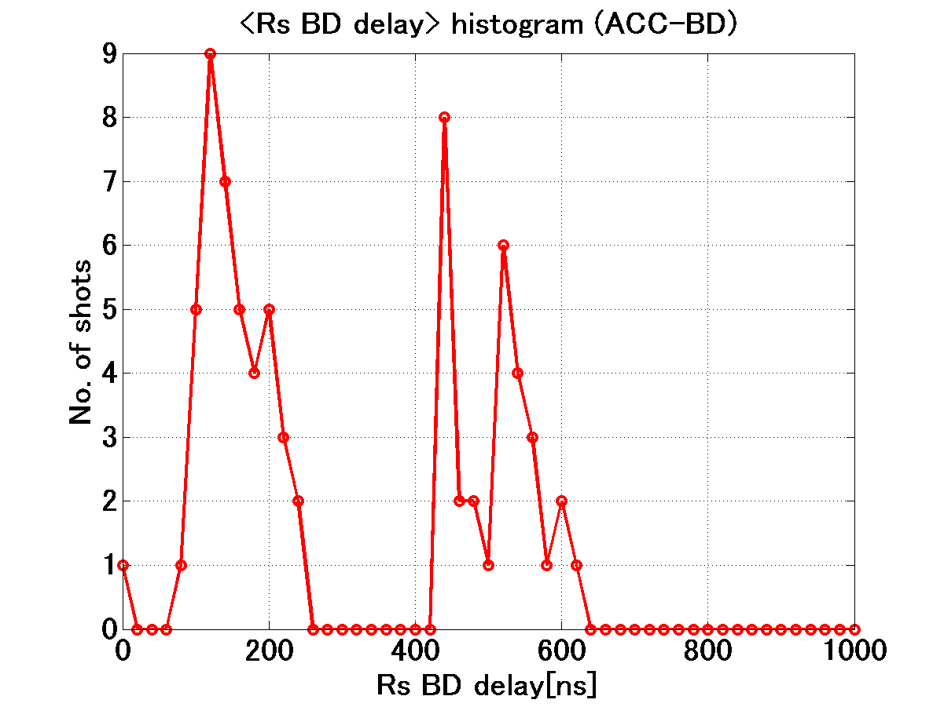
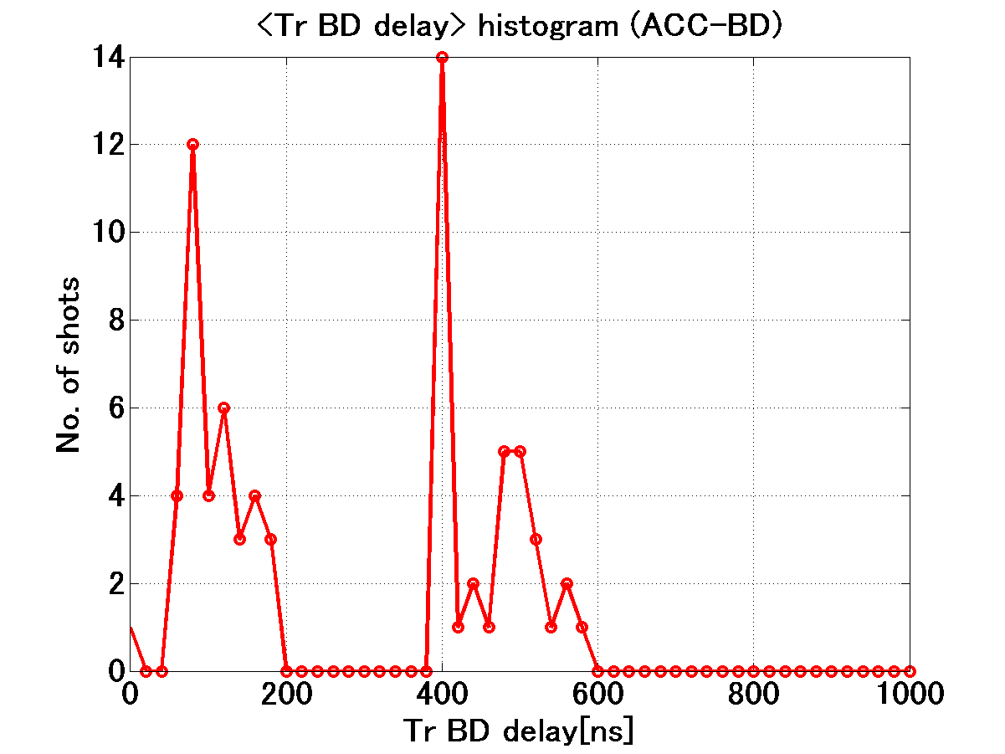
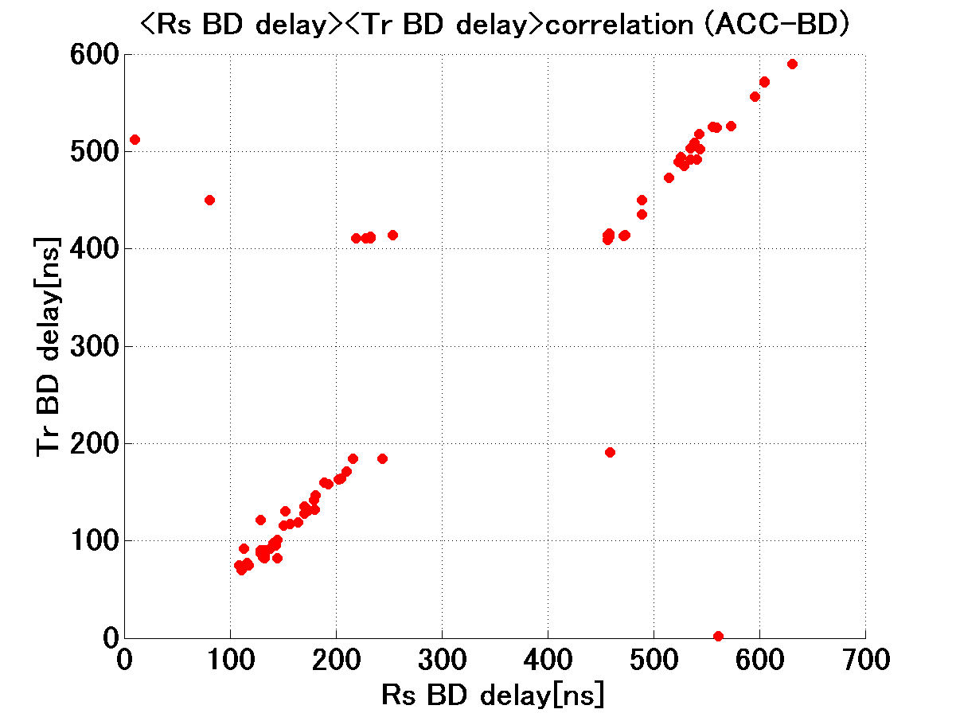
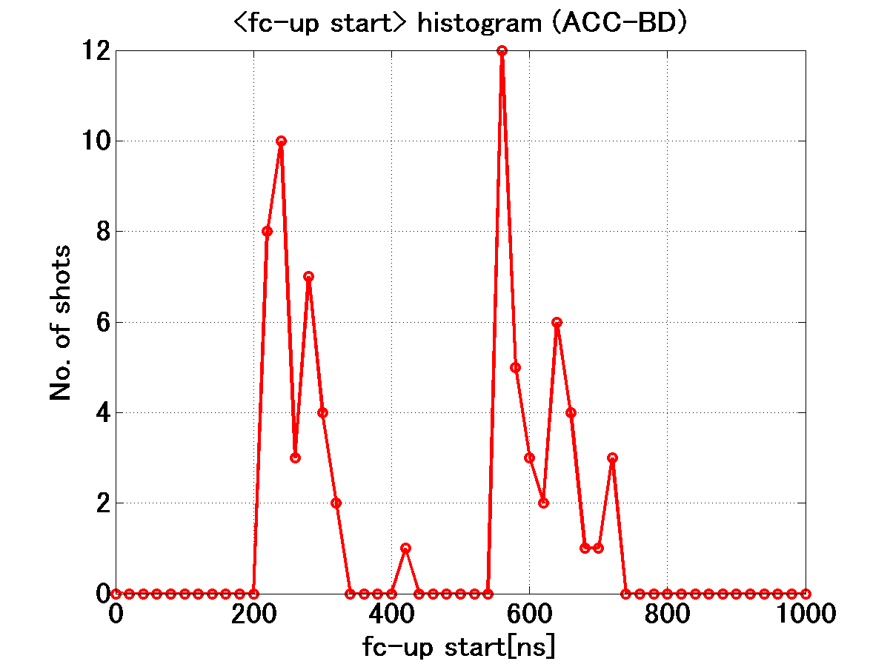
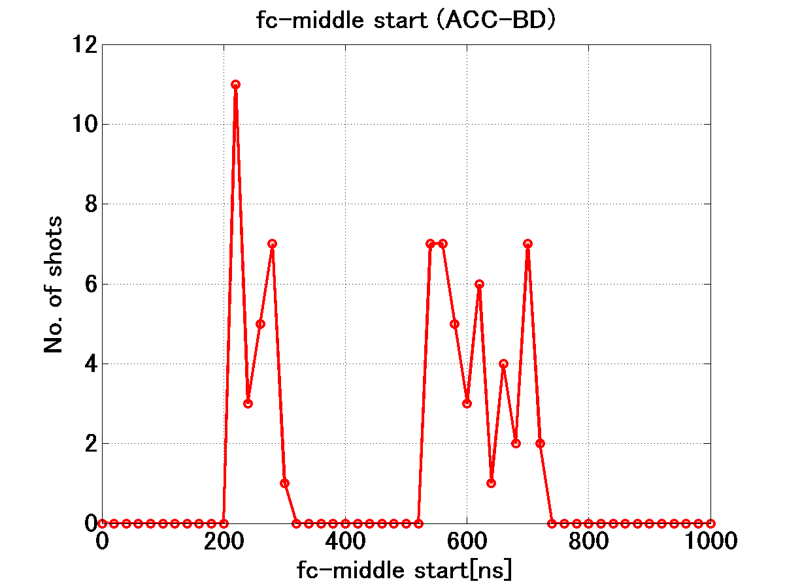
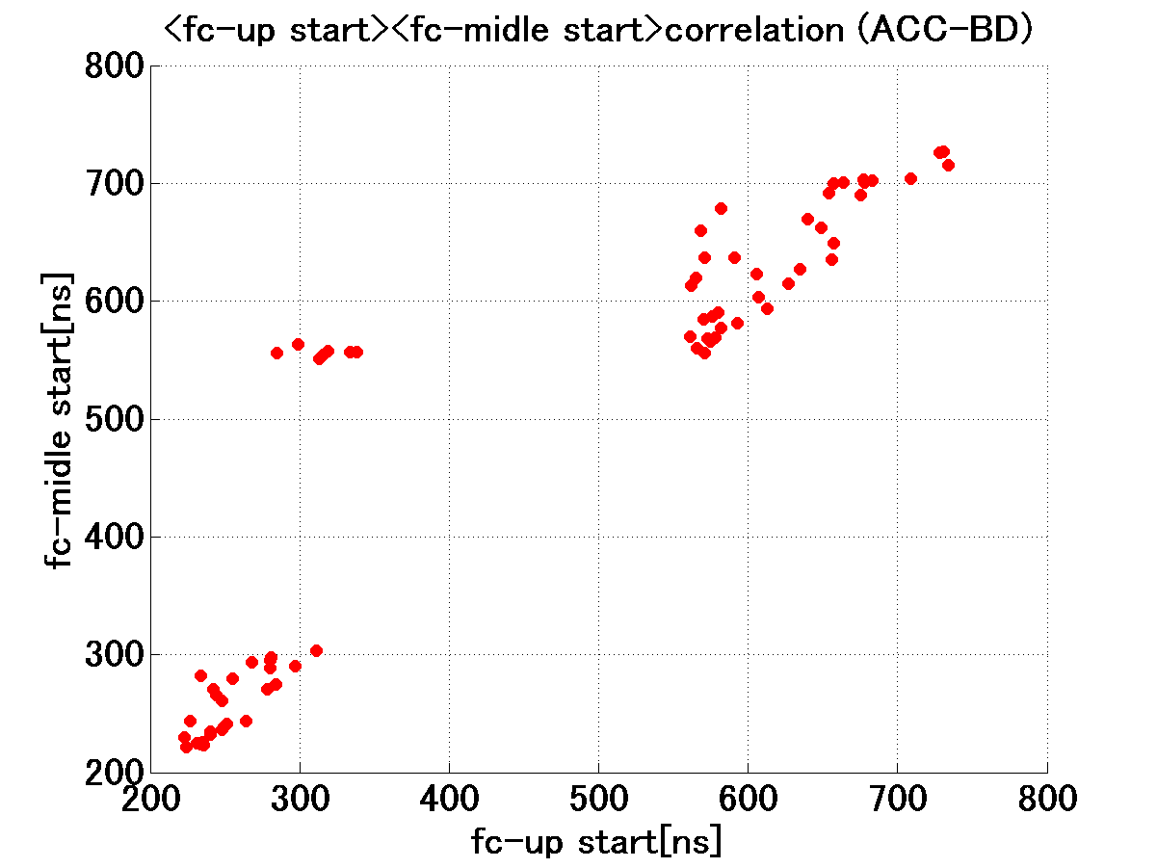
BD timings
Rs delay
Tr delay
Tr delay vs Rs delay
Mid delay
UP delay
UP delay vs Mid delay
Equal probability for BD to happen in former/latter pulse.

Slide 13
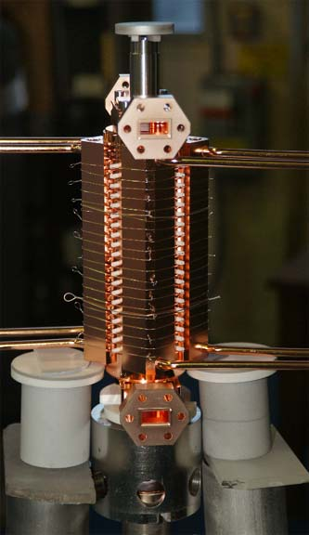
Need better bonding quality!?
Brazing
Machining
Diffusion bonding at high temperature
Need good flatness for the surface to deform within a finite bonding time at high temperature.
Vacuum baking.
Only for surface change. No bonding quality change.
TD18_#3
After high gradient test
SEM taken at CERN
See a gap !?

Slide 14
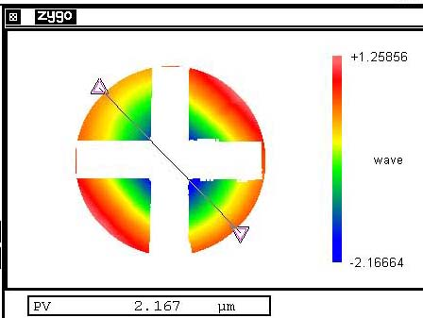
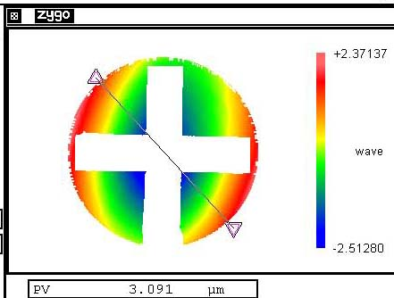
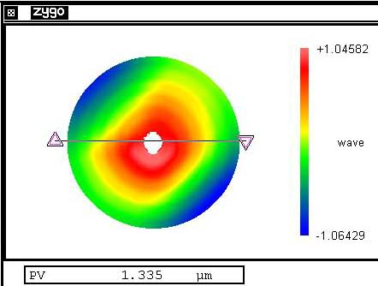
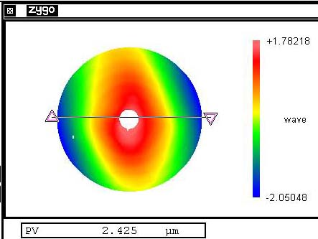
Flatness of cells for TD18_#2
Even ~3 micron flatness was accepted as long as the opposite side was reversely deformed.
Judgment was done by estimating the residual flatness error to be less than 0.5 micron after sandwiching by flat plates.
Mostly potato chip type (right) but one or two cases the conical shape (left) was accepted.
TD18_#2_15b
TD18_#2_09b_2

